Slide 1
Surrogate-Enhanced Parameter Inference for Function-Valued Models
Christopher Albert¹, Ulrich Callies², Udo von Toussaint¹
¹Max Planck Institute for Plasma Physics, 85748 Garching, Germany
²Helmholtz Center Hereon, 21502 Geesthacht, Germany
MaxEnt Conference, 6th July 2021
Special thanks to Katharina Rath and Sascha Ranftl for useful discussions!

Slide 2
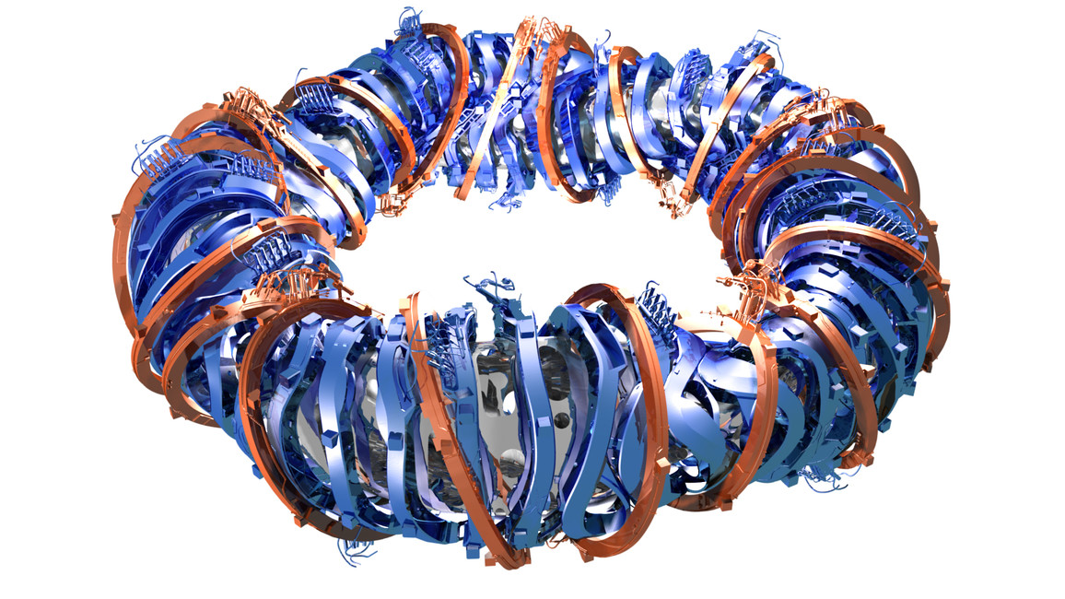
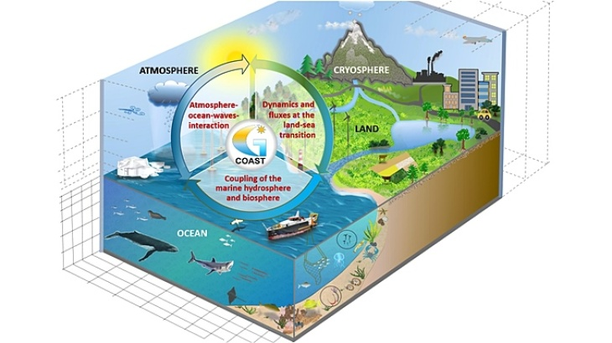
Collaborating institutes
Max Planck Institute for Plasma Physics (IPP) Numerical Methods in Plasma Physics (NMPP)
Tokamak ASDEX Upgrade (Garching) and Stellarator W7-X (Greifswald)
Structure-preserving methods, mathematical foundations, high-performance computing
Helmholtz Center Hereon Coastal Systems - Analysis and Modeling
Physics, chemistry and biology of coastal systems
Combination of observational, mechanistic and probabilistic modeling for data analysis

Slide 3
Outline
Application case
Calibration of riverine diatom model
Solution strategy to be faster
Ingredients
Delayed acceptance MCMC
Linear dimension reduction via PCA
Results
Bayesian hierarchical models and fractional norms
Conclusion and Outlook

Slide 4
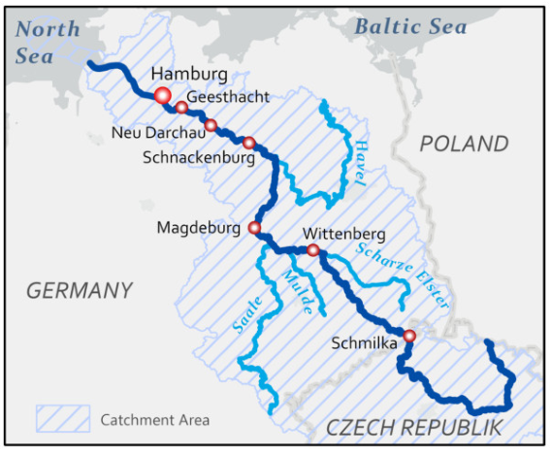
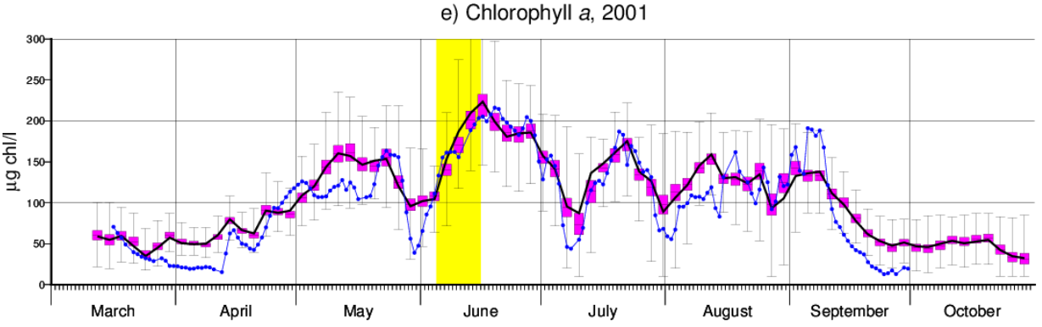
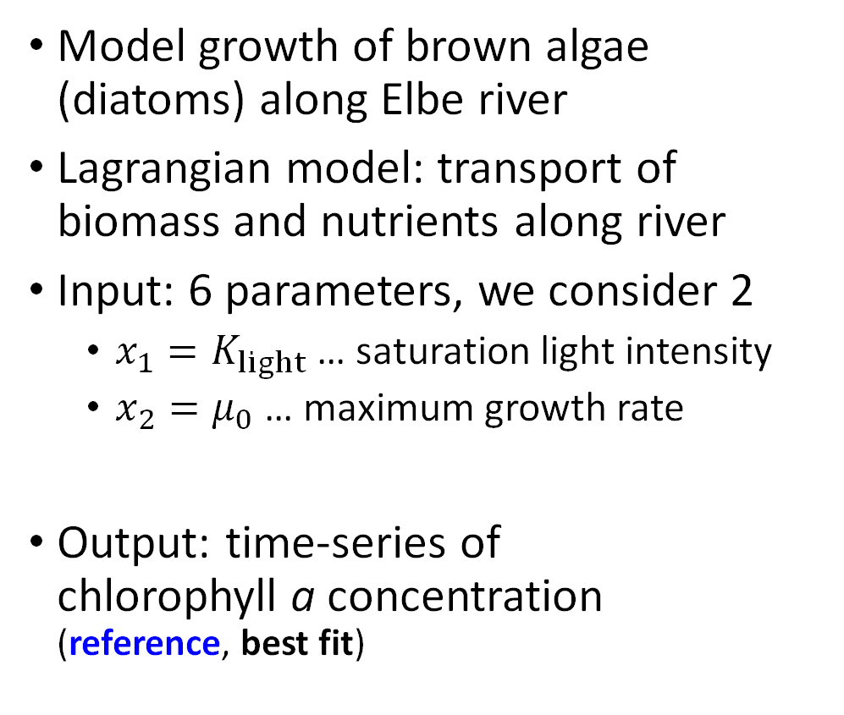
Application case
Model growth of brown algae (diatoms) along Elbe river
Lagrangian model: transport of biomass and nutrients along river
Input: 6 parameters, we consider 2
$x_{1}=K_{light}$ … saturation light intensity
$x_{2}=μ_{0}$ … maximum growth rate
Output: time-series of chlorophyll a concentration (reference, best fit)
U. Callies, M. Scharfe, M. Ratto. Calibration and Uncertainty Analysis of a Simple Model of Silica-Limited Diatom Growth in the Elbe River. Ecol. Model. 213, 229 (2008)

Slide 5
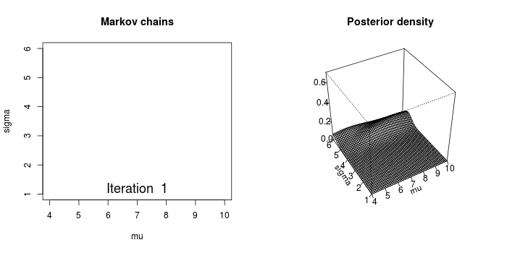

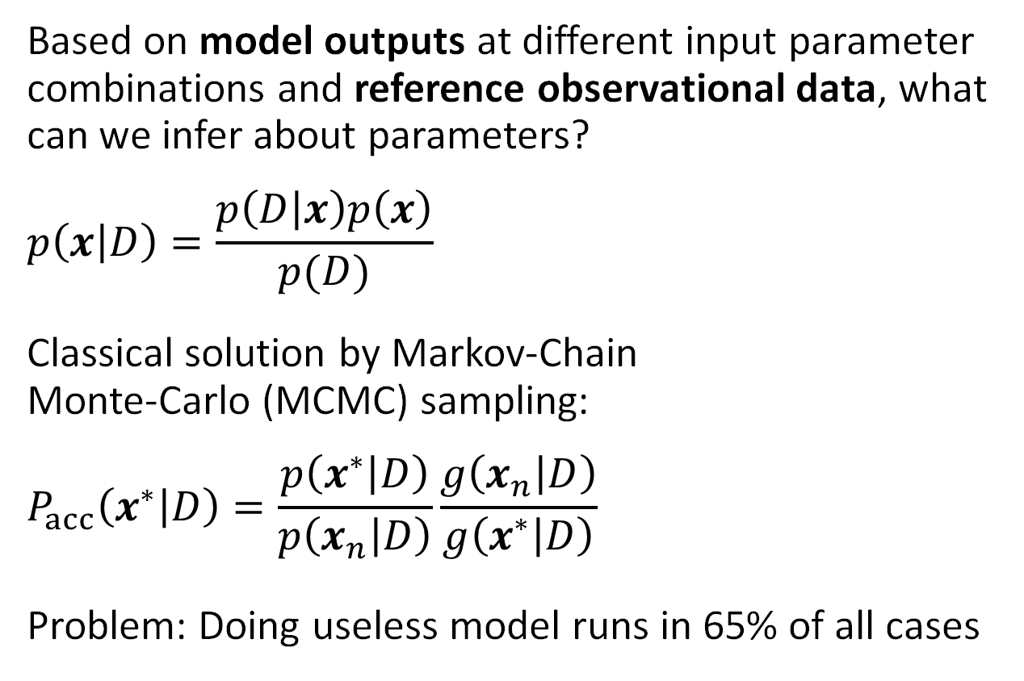
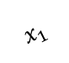
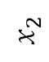
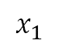
Model calibration / parameter inference
Based on model outputs at different input parameter combinations and reference observational data, what can we infer about parameters?
$$p\left(x | D\right)=\frac{p\left(D | x\right)p\left(x\right)}{p(D)}$$
Classical solution by Markov-Chain Monte-Carlo (MCMC) sampling:
$$P_{acc}\left(x^{∗} | D\right)=\frac{p\left(x^{∗} | D\right)}{p\left(x_{n} | D\right)}\frac{g\left(x_{n} | D\right)}{g\left(x^{∗} | D\right)}$$
Problem: Doing useless model runs in 65% of all cases
$$x_{2}$$
$$x_{2}$$
$$x_{1}$$
$$x_{1}$$
Animation by M.B. Joseph, https://github.com/mbjoseph

Slide 6
Strategy for a more efficient solution
Need a surrogate that approximates full model
Refine surrogate near posterior mode -> Bayesian global optimization
Use this surrogate to save model runs in MCMC
Speciality
Instead of direct surrogate for log-likelihood/cost, we create a surrogate for the full function-valued (time-series) output
This leads to more flexibility, but requires dimension reduction
Marginalization over multiple possible likelihoods/error norms possible (Bayesian hierarchical model)

Slide 7
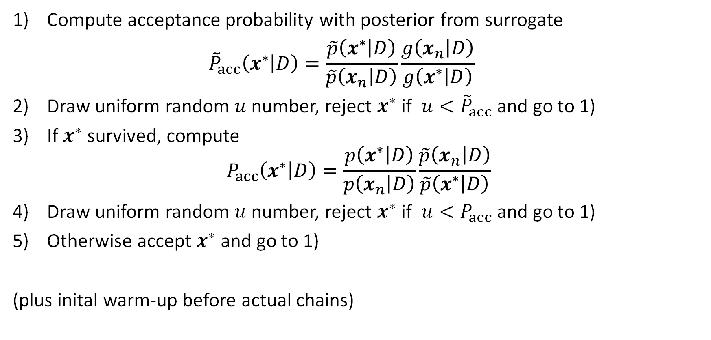

Delayed acceptance Markov-Chain-Monte-Carlo
Compute acceptance probability with posterior from surrogate ${\tilde{P}}_{acc}\left(x^{∗} | D\right)=\frac{\tilde{p}\left(x^{∗} | D\right)}{\tilde{p}\left(x_{n} | D\right)}\frac{g\left(x_{n} | D\right)}{g\left(x^{∗} | D\right)}$
Draw uniform random $u$ number, reject $x^{∗}$if $u<{\tilde{P}}_{acc}$ and go to 1)
If $x^{∗}$survived, compute $P_{acc}\left(x^{∗} | D\right)=\frac{p\left(x^{∗} | D\right)}{p\left(x_{n} | D\right)}\frac{\tilde{p}\left(x_{n} | D\right)}{\tilde{p}\left(x^{∗} | D\right)}$
Draw uniform random $u$ number, reject $x^{∗}$if $u<P_{acc}$ and go to 1)
Otherwise accept $x^{∗}$ and go to 1)
(plus inital warm-up before actual chains)
J.A. Christen, C. Fox. Markov Chain Monte Carlo Using an Approximation. J. Comput. Graph. Stat. 14, 795 (2005)

Slide 8
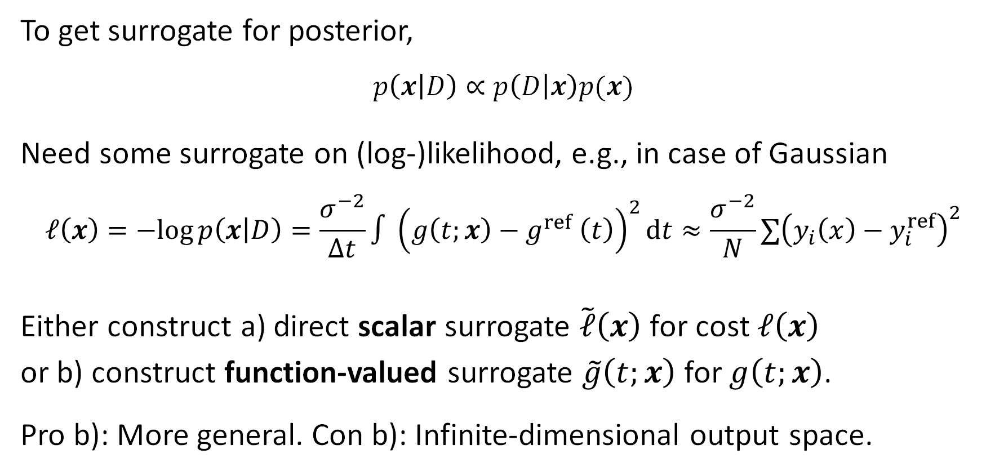

Surrogate for the posterior
To get surrogate for posterior,
$$p\left(x | D\right)∝p\left(D | x\right)p(x)$$
Need some surrogate on (log-)likelihood, e.g., in case of Gaussian
$$ℓ\left(x\right)=−log{p\left(x | D\right)}=\frac{σ^{−2}}{Δt}∫{\left(g\left(t;x\right)−g^{ref} \left(t\right)\right)}^{2}dt≈\frac{σ^{−2}}{N}∑{\left(y_{i}\left(x\right)−y_{i}^{ref}\right)}^{2}$$
Either construct a) direct scalar surrogate $\tilde{ℓ}\left(x\right)$ for cost $ℓ\left(x\right)$
or b) construct function-valued surrogate $\tilde{g}\left(t;x\right)$for $g\left(t;x\right)$.
Pro b): More general. Con b): Infinite-dimensional output space.

Slide 9
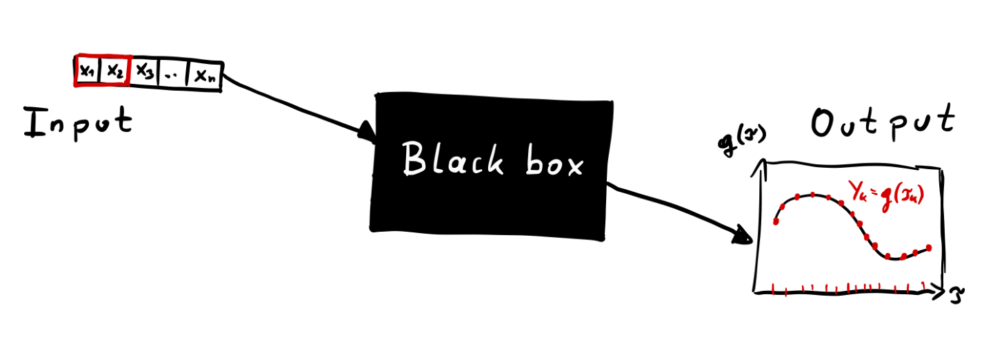
Function-valued model

Slide 10
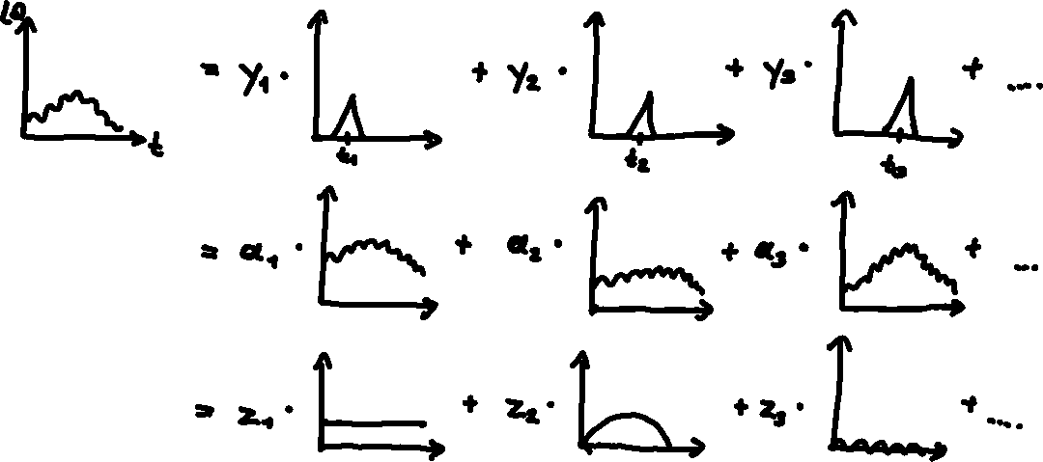

Linear representation in terms of …
values at support points
observed functions
principal components

Slide 11
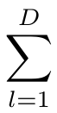
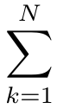
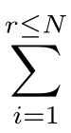
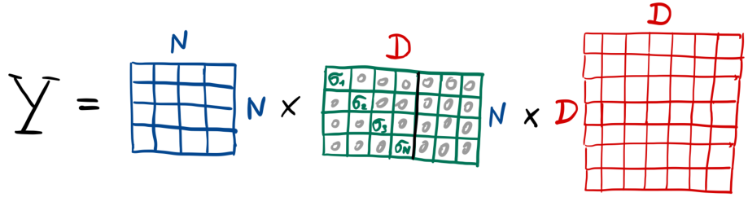
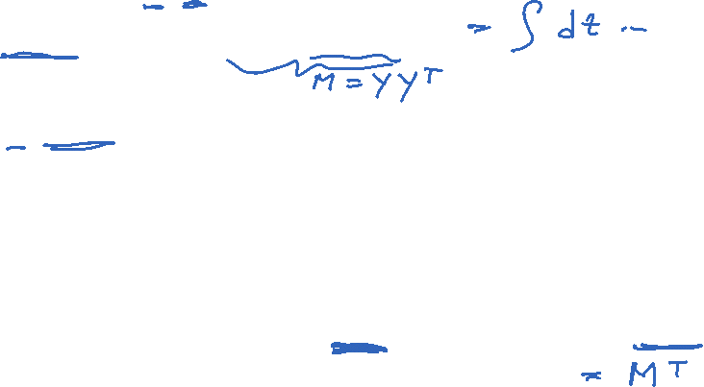
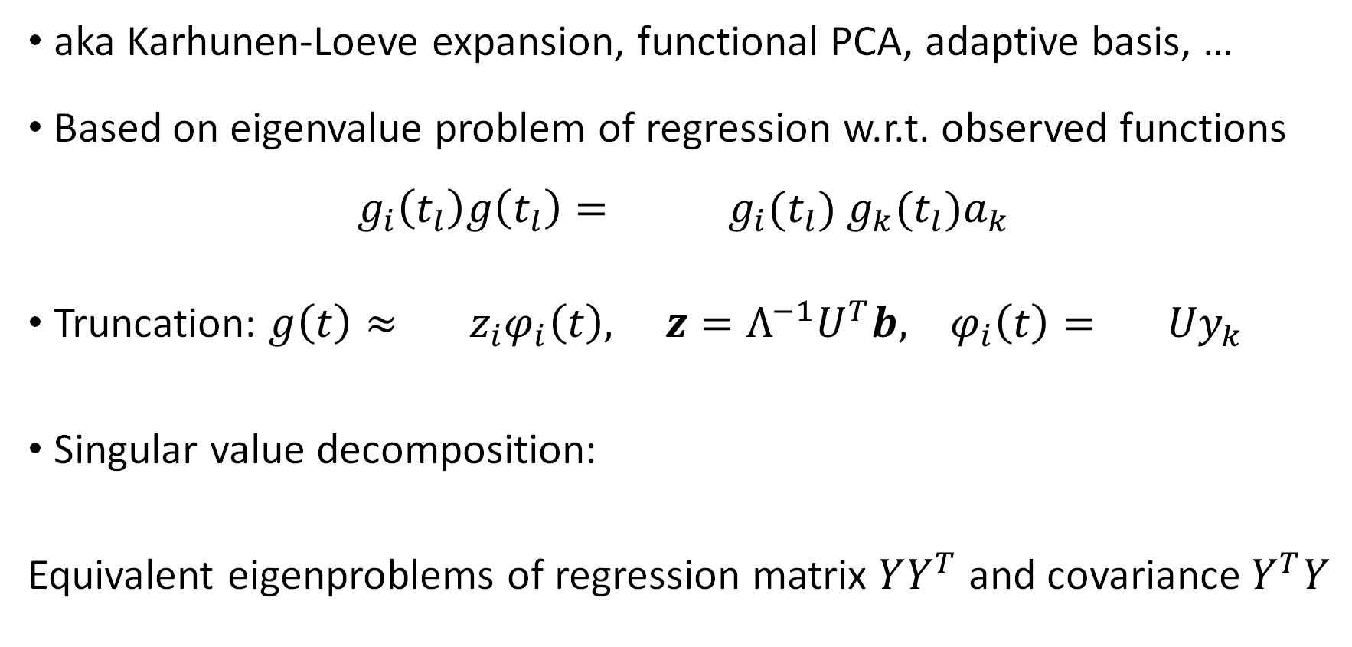
Surrogate in eigenfunctions = principal components
aka Karhunen-Loeve expansion, functional PCA, adaptive basis, …
Based on eigenvalue problem of regression w.r.t. observed functions $g_{i}\left(t_{l}\right)g\left(t_{l}\right)= g_{i}(t_{l}) g_{k}(t_{l})a_{k}$
Truncation: $g\left(t\right)≈ z_{i}φ_{i}\left(t\right), z=Λ^{−1}U^{T}b, φ_{i}\left(t\right)= Uy_{k}$
Singular value decomposition:
Equivalent eigenproblems of regression matrix $YY^{T}$ and covariance $Y^{T}Y$
Bishop, Pattern recongnition and machine learning, Springer (2006) Ch. 12

Slide 12
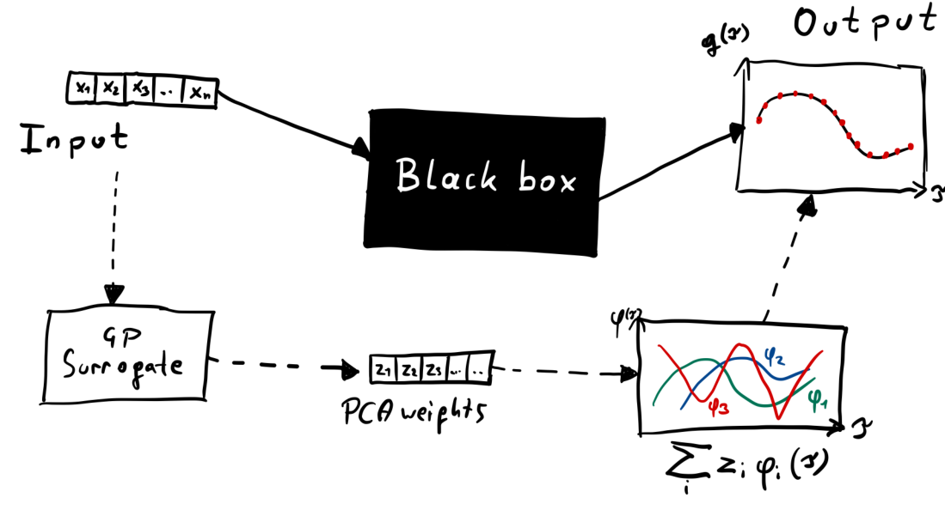
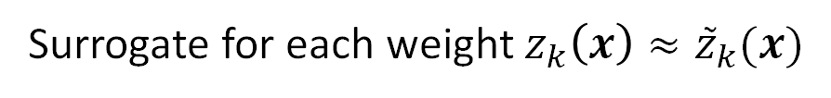

Surrogate for function-valued model
Surrogate for each weight $z_{k}\left(x\right)≈{\tilde{z}}_{k}(x)$

Slide 13
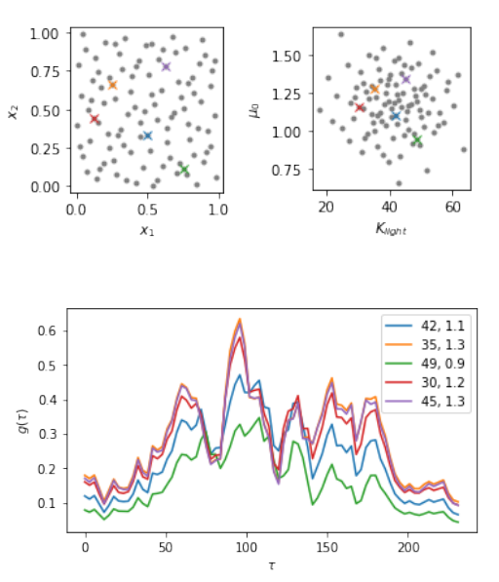
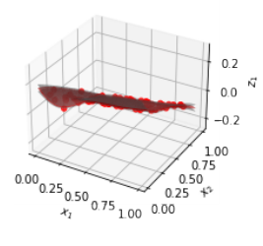
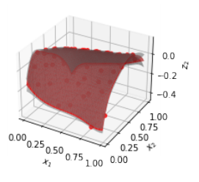
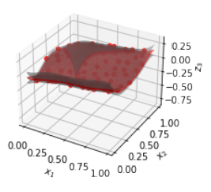
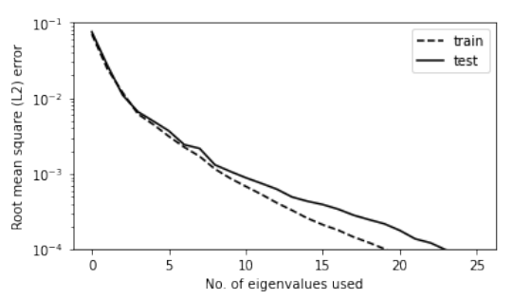
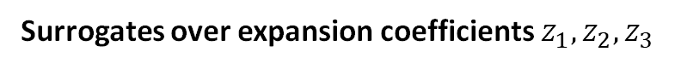
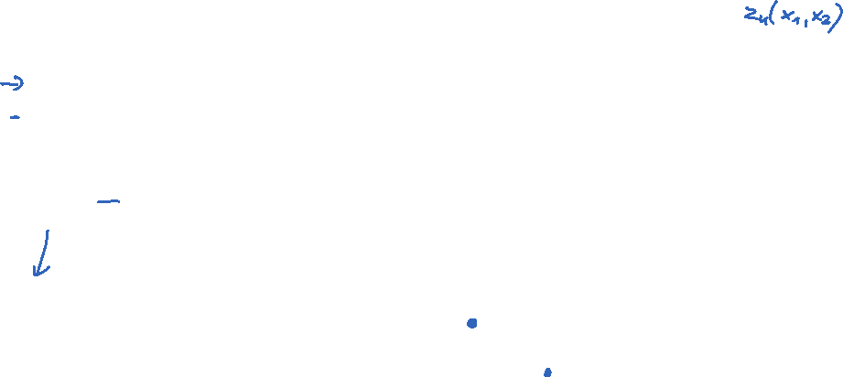
Results for riverine diatom model
Training samples
Surrogates over expansion coefficients $z_{1},z_{2},z_{3}$
Average reconstruction error

Slide 14
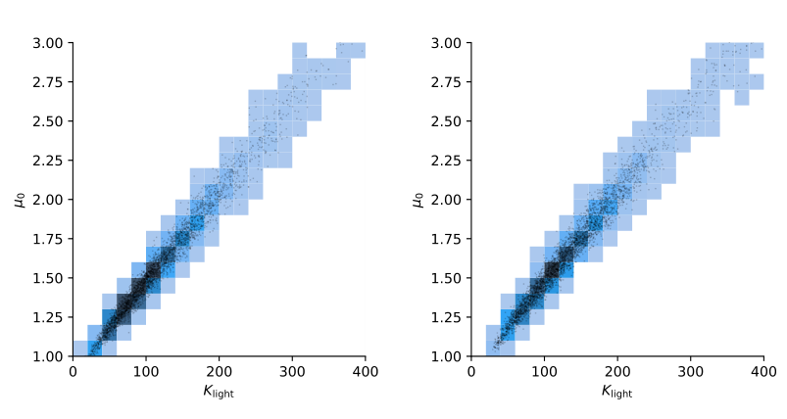
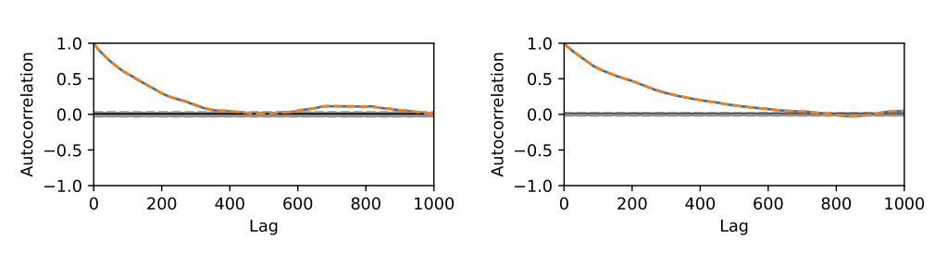
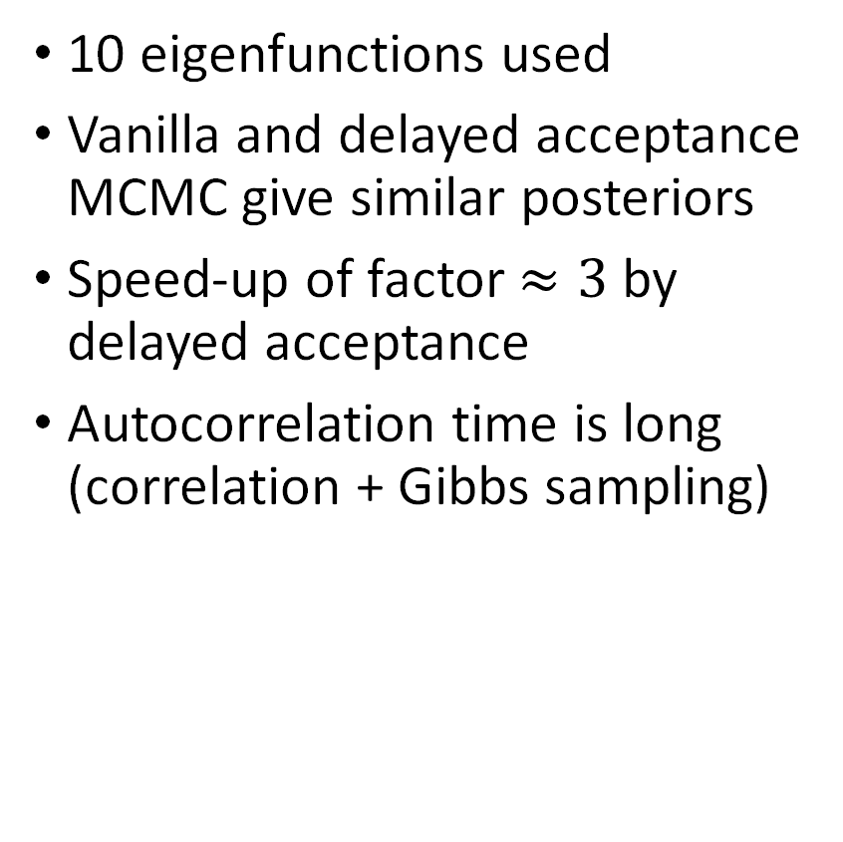
Results for riverine diatom model
10 eigenfunctions used
Vanilla and delayed acceptance MCMC give similar posteriors
Speed-up of factor $≈3$ by delayed acceptance
Autocorrelation time is long (correlation + Gibbs sampling)
Vanilla MCMC
Delayed acceptance MCMC
Posterior
Autocorrelation

Slide 15
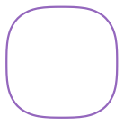
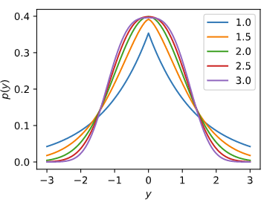
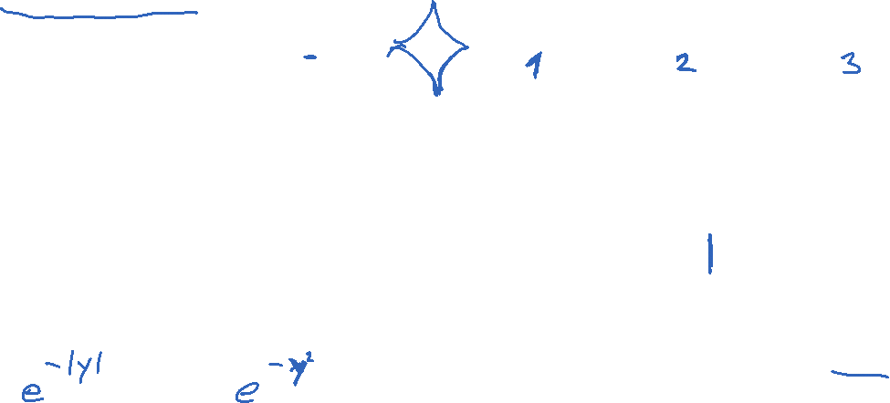
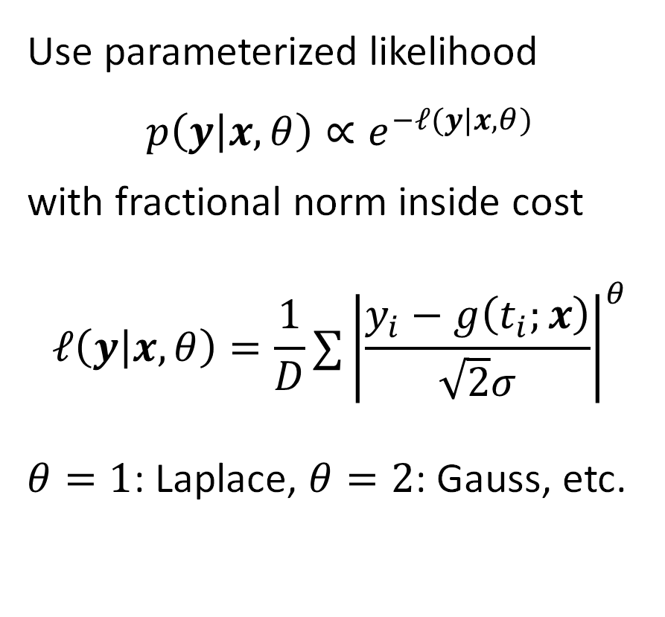
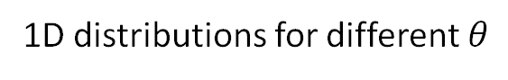
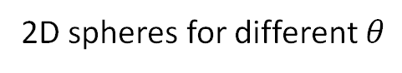
Bayesian hierarchical model with fractional norms
Use parameterized likelihood $$p\left(y | x,θ\right)∝e^{−ℓ(y|x,θ)}$$
with fractional norm inside cost
$$ℓ\left(y | x,θ\right)=\frac{1}{D}∑{\left|\frac{y_{i}−g\left(t_{i};x\right)}{\sqrt{2}σ}\right|}^{θ}$$
$θ=1$: Laplace, $θ=2$: Gauss, etc.
2D spheres for different $θ$
1D distributions for different $θ$

Slide 16
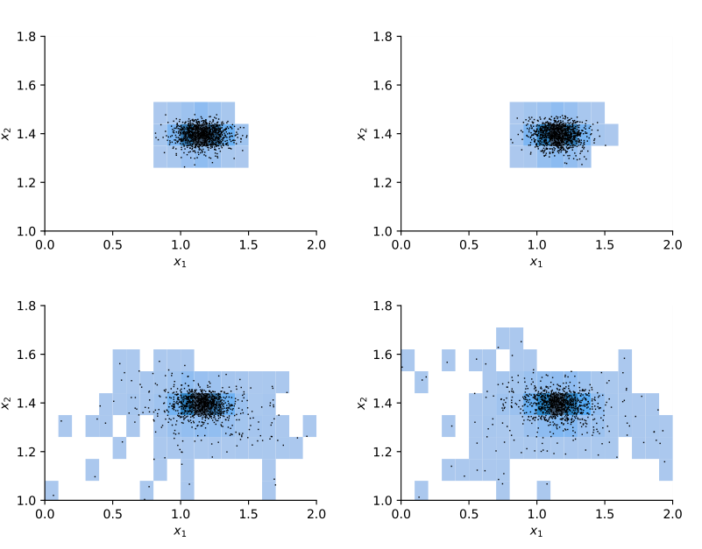
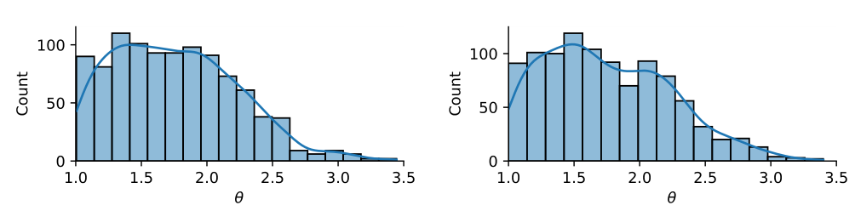

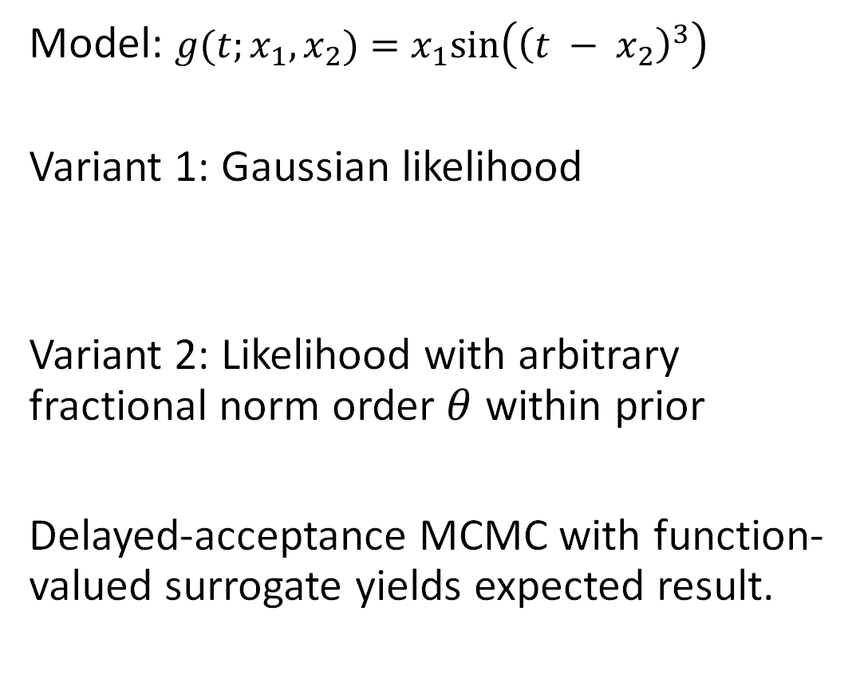
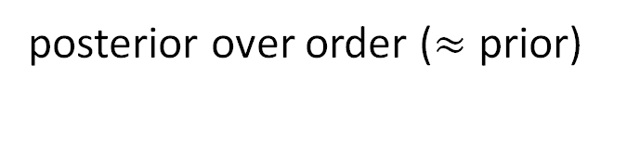
Marginalizing over fractional norms on a toy model
Model: $g(t;x_{1},x_{2})=x_{1}sin\left({\left(t − x_{2}\right)}^{3}\right)$
Variant 1: Gaussian likelihood
Variant 2: Likelihood with arbitrary fractional norm order $θ$ within prior
Delayed-acceptance MCMC with function-valued surrogate yields expected result.
Vanilla MCMC
Delayed acceptance
posterior over order ($≈$ prior)

Slide 17
Conclusion and Outlook
In our application, function-valued surrogates were effective when implemented via GP regression of weights for first few eigenfunctions.
Delayed acceptance MCMC can be effective with these surrogates.
The approach leads to more flexibility in the likelihood.
Outlook:
Sample over function-valued input (curse of dimensionality looming)
Try (nonlinear) techniques for surrogates and dimension reduction
No way around tailoring to each application

Slide 18
Thank you for your attention!
Code: https://github.com/redmod-team/maxent21
proFit toolkit: https://github.com/redmod-team/profit

Slide 19
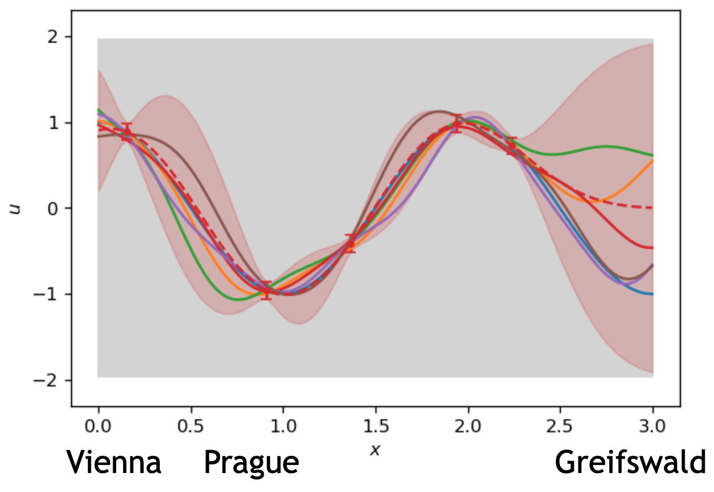
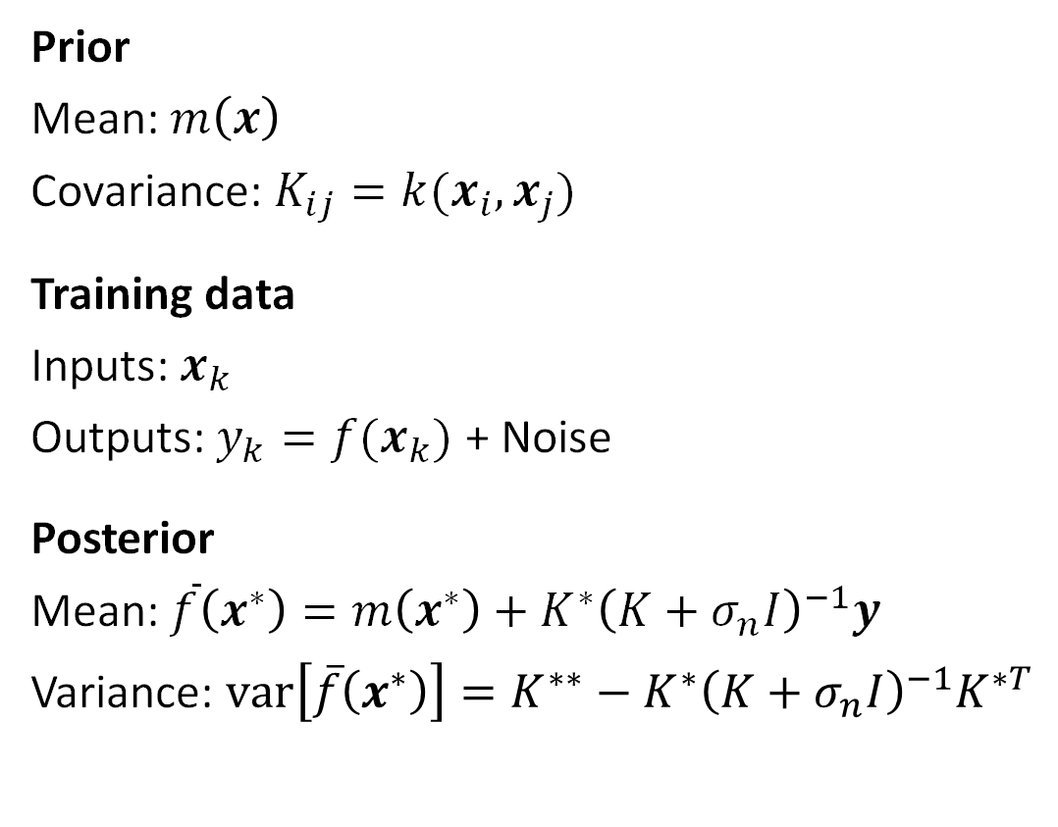
Gaussian process regression
Prior
Mean: $m\left(x\right)$
Covariance: $K_{ij}=k(x_{i},x_{j})$
Training data
Inputs: $x_{k}$
Outputs: $y_{k}=f(x_{k})$ + Noise
Posterior
Mean: $\overline{f}\left(x^{∗}\right)=m\left(x^{∗}\right)+K^{∗}{\left(K+σ_{n}I\right)}^{−1}y$
Variance: $var\left[\overline{f}\left(x^{∗}\right)\right]=K^{∗∗}−K^{∗}{\left(K+σ_{n}I\right)}^{−1}K^{∗T}$
http://www.infinitecuriosity.org/vizgp/?utm_campaign=Data_Elixir&utm_source=Data_Elixir_338
C. E. Rasmussen & C. K. I. Williams. Gaussian Processes for Machine Learning. MIT Press, 2006.

Slide 20
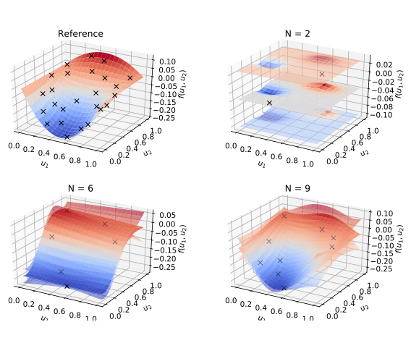
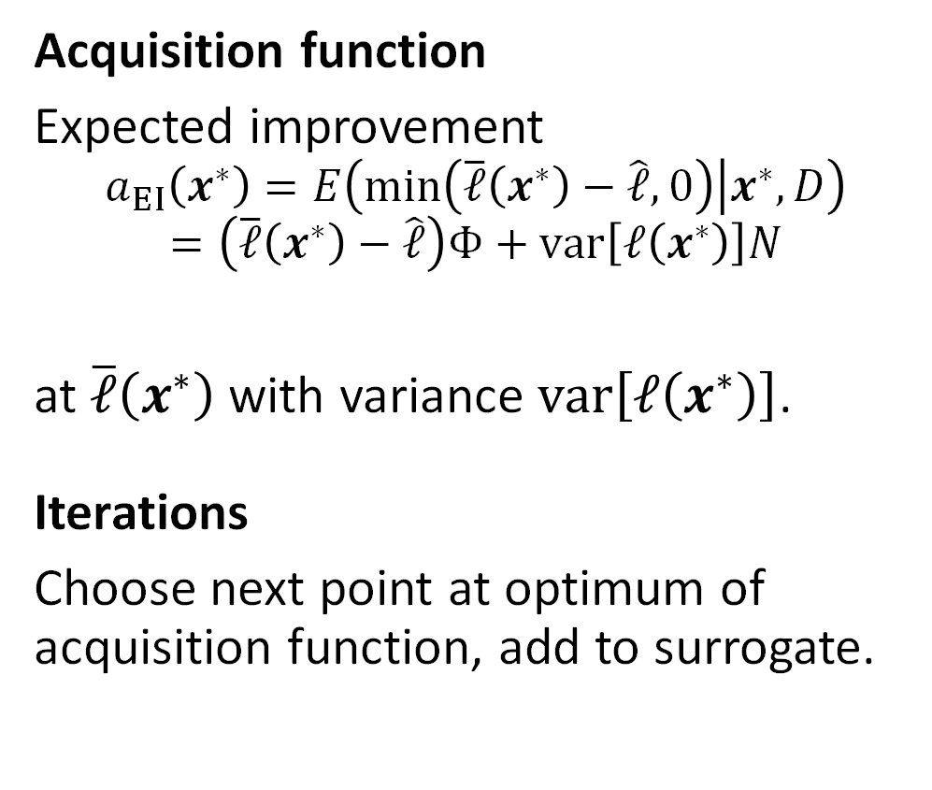
Bayesian global optimization
Acquisition function
Expected improvement
$$a_{EI}\left(x^{∗}\right)=E\left(min\left(\overline{ℓ}\left(x^{∗}\right)−\hat{ℓ},0\right) | x^{∗},D\right)$$
$$=\left(\overline{ℓ}\left(x^{∗}\right)−\hat{ℓ}\right)Φ+var\left[ℓ\left(x^{∗}\right)\right]N$$
at $\overline{ℓ}\left(x^{∗}\right)$ with variance $var\left[ℓ\left(x^{∗}\right)\right]$.
Iterations
Choose next point at optimum of acquisition function, add to surrogate.
M.A. Osborne et al. Gaussian Processes for Global Optimization. Learning and Intelligent Opt, 2009.

